Slide 1
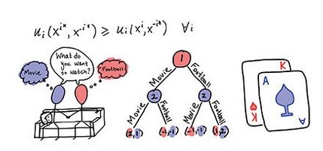
Game Theory
[Continued]
From
Mathematical Optimization and Economic Theory
Jacob Wyngaard

Slide 2
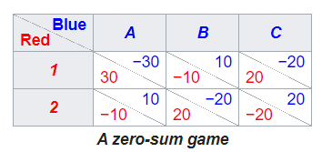

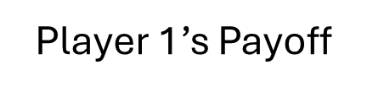
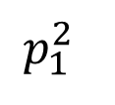
Zero Sum Game with 2 x 3 Payoff Matrix
Player 1’s Payoff
B
C
20
30
3
6
-10
-2
  The Saddle Point
-10
-20
$$p_{1}^{2}$$
-4
20
5
4
  $$\frac{8}{17}$$
A

Slide 3

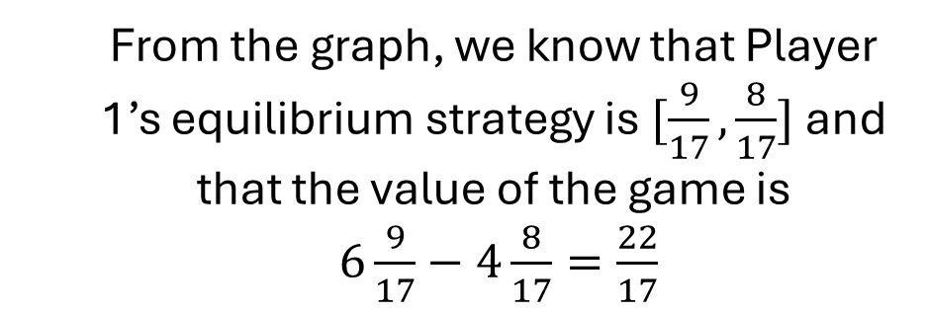



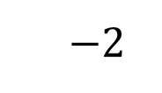
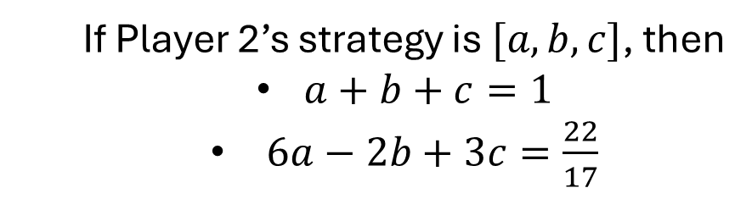

Zero Sum Game with 2 x 3 Payoff Matrix
Player 1’s Payoff
  From the graph, we know that Player 1’s equilibrium strategy is $[\frac{9}{17},\frac{8}{17}]$ and that the value of the game is
  $6\frac{9}{17}−4\frac{8}{17}=\frac{22}{17}$
  $$6$$
B
C
  $$3$$
  The Saddle Point
  How do we find Player 2’s best strategy?
$$p_{1}^{2}$$
  If Player 2’s strategy is $[a,b,c]$, then
  $a+b+c=1$
  $6a−2b+3c=\frac{22}{17}$
  $$\frac{8}{17}$$
  $$−2$$
A
  $$−4$$
  Three unknowns, two constraints

Slide 4

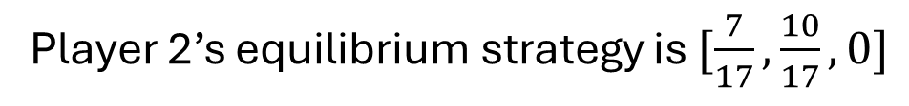

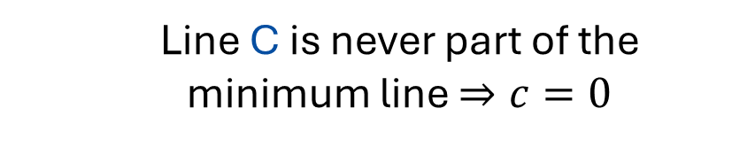

Zero Sum Game with 2 x 3 Payoff Matrix
Player 1’s Payoff
  $a+b+c=1$
  $6a−2b+3c=\frac{22}{17}$
  $$6$$
B
  What if we could eliminate one of Player 2’s strategies?
C
  $$3$$
  Line C is never part of the minimum line $⇒c=0$
  The Saddle Point
$$p_{1}^{2}$$
  Now we have the system of equations:
  $$\frac{8}{17}$$
  $$−2$$
  $a+b=1$
  $6a−2b=\frac{22}{17}$
A
  $$−4$$
Player 2’s equilibrium strategy is $[\frac{7}{17},\frac{10}{17},0]$

Slide 5
Zero Sum Game with 2 x 3 Payoff Matrix
  How do we eliminate strategy C using the payoff matrix?
  We are allowed to eliminate strictly dominated strategies; the dominant strategies can be mixed strategies!
20
30
3
6
-10
-2
-10
-20
-4
20
5
4
  If strategy C can be strictly dominated by a convex hull of other strategies, then C can be eliminated

Slide 6
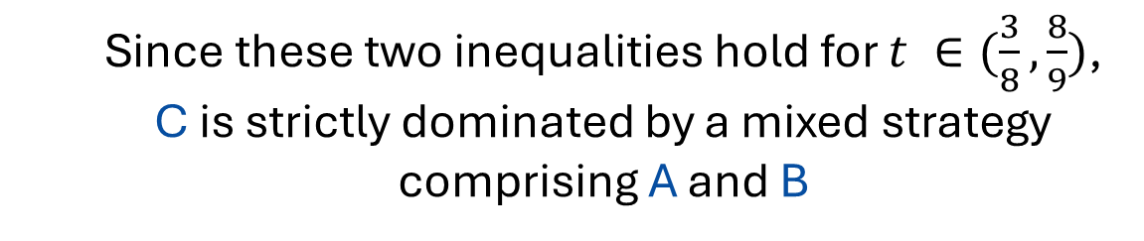

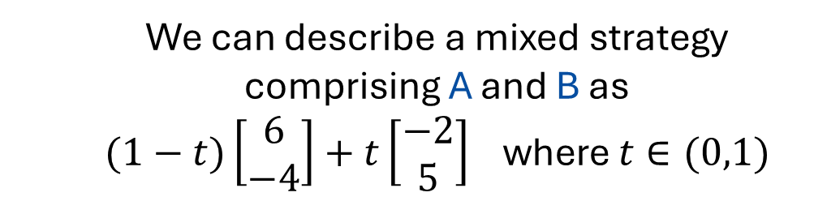
Zero Sum Game with 2 x 3 Payoff Matrix
  We can describe a mixed strategy comprising A and B as
  $(1−t)\left[\begin{matrix}6 \\ −4\end{matrix}\right]+t\left[\begin{matrix}−2 \\ 5\end{matrix}\right]$ where $t∈(0,1)$
  For this mixed strategy to dominate C, the following two inequalities must hold:
20
30
3
6
-10
-2
-10
-20
  $6\left(1−t\right)−2t<3$
  $−4\left(1−t\right)+5t<4$
-4
20
5
4
  Since these two inequalities hold for $t ∈(\frac{3}{8},\frac{8}{9})$, C is strictly dominated by a mixed strategy comprising A and B

Slide 7
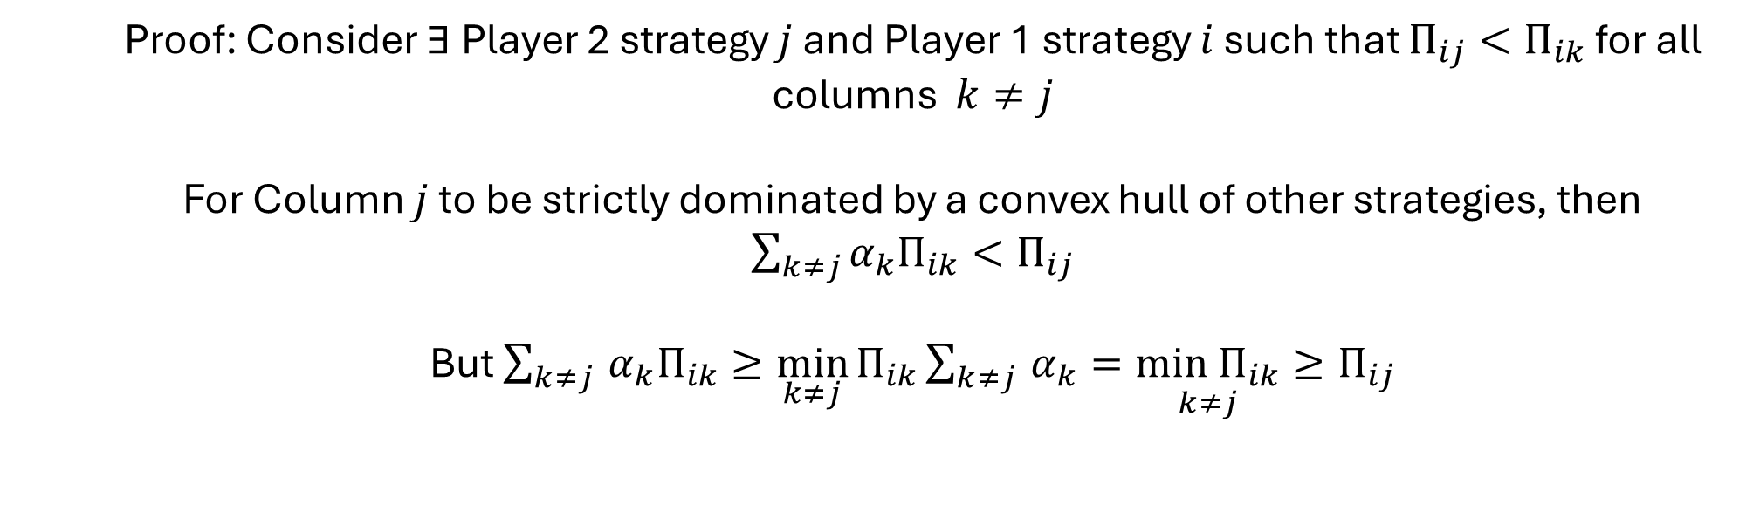
Zero Sum Game with 2 x 3 Payoff Matrix
  Does every zero-sum game with a 2 x 3 payoff matrix have a Player 2 strategy that’s strictly dominated by a convex hull of the other strategies?
  Claim: A Player 2 strategy cannot be strictly dominated if it contains a row minimum
  Proof: Consider $∃$Player 2 strategy $j$ and Player 1 strategy $i$ such that $Π_{ij}<Π_{ik}$ for all columns $k≠j$
  For Column $j$ to be strictly dominated by a convex hull of other strategies, then $\sum_{k≠j}{α_{k}Π_{ik}}<Π_{ij}$
  But $\sum_{k≠j }{α_{k}Π_{ik}}≥\min_{k≠j}{Π_{ik}\sum_{k≠j }{α_{k}}=\underset{k≠j}{min Π_{ik}}}≥Π_{ij}$

Slide 8
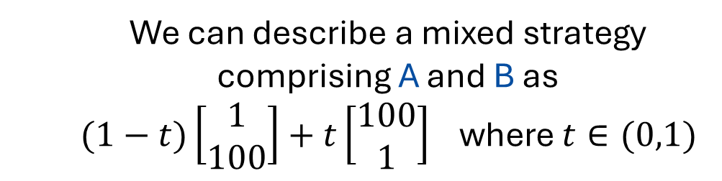
Zero Sum Game with 2 x 3 Payoff Matrix
  Does every zero-sum game with a 2 x 3 payoff matrix have a Player 2 strategy that’s strictly dominated by a convex hull of the other strategies?
  Because A and B contain row minimums, the only strategy that could be strictly dominated in this example is C
20
30
2
1
-10
100
-10
-20
100
20
1
3
  We can describe a mixed strategy comprising A and B as
  $(1−t)\left[\begin{matrix}1 \\ 100\end{matrix}\right]+t\left[\begin{matrix}100 \\ 1\end{matrix}\right]$ where $t∈(0,1)$

Slide 9
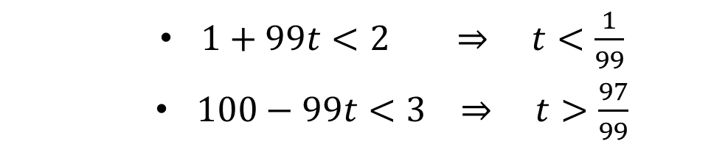

Zero Sum Game with 2 x 3 Payoff Matrix
  For a mixed strategy of A and B to dominate C, the following two inequalities must hold:
  $\left(1−t\right)+100t<2$
  $100\left(1−t\right)+t<3$
20
30
2
1
-10
100
  But this requires that:
-10
-20
100
20
1
3
  $1+99t<2 ⇒ t<\frac{1}{99}$
  $100−99t<3 ⇒ t>\frac{97}{99}$
  No mixed strategy of A and B to dominates C!

Slide 10






Zero Sum Game with 2 x 3 Payoff Matrix
  How do we find the Nash equilibrium for this game?
Player 1’s Payoff
A
  $$6$$
B
20
  $$3$$
30
2
1
-10
100
C
-10
-20
100
20
1
3
$$p_{1}^{2}$$
  $$.98$$
  $$−2$$
  Player 1’s Strategy: $[.02,.98]$
  At Nash Equilibrium

Slide 11

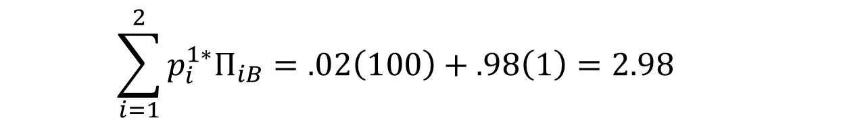
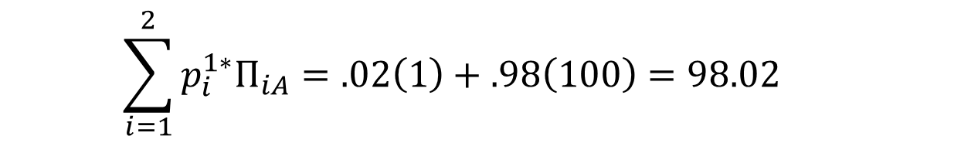
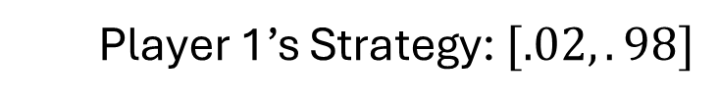
Zero Sum Game with 2 x 3 Payoff Matrix
  We now use the Strong Minimax Theorem:
  Either $\sum_{i=1}^{m}{p_{i}^{1∗}Π_{ij}=V}$ or $p_{j}^{2∗}=0$ for $j=A,B,C$
  Player 1’s Strategy: $[.02,.98]$
  $$\sum_{i=1}^{2}{p_{i}^{1∗}Π_{iA}=.02\left(1\right)+.98\left(100\right)=98.02}$$
20
30
2
1
-10
100
-10
-20
  $$\sum_{i=1}^{2}{p_{i}^{1∗}Π_{iB}=.02\left(100\right)+.98\left(1\right)=2.98}$$
100
20
1
3
  $$\sum_{i=1}^{2}{p_{i}^{1∗}Π_{iC}=.02\left(2\right)+.98\left(3\right)=2.98}$$

Slide 12
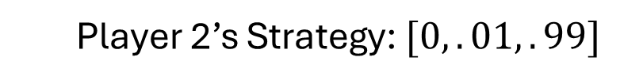
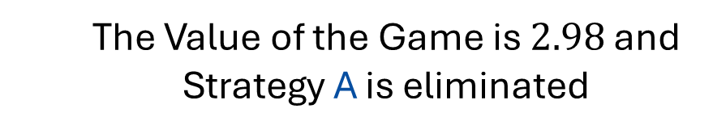
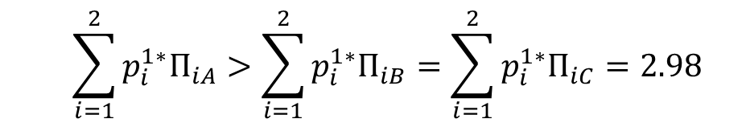
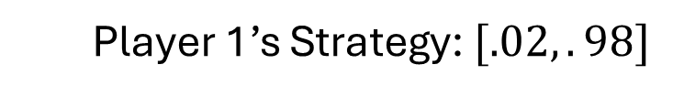
Zero Sum Game with 2 x 3 Payoff Matrix
  Player 1’s Strategy: $[.02,.98]$
  $$\sum_{i=1}^{2}{p_{i}^{1∗}Π_{iA}}>\sum_{i=1}^{2}{p_{i}^{1∗}Π_{iB}=\sum_{i=1}^{2}{p_{i}^{1∗}Π_{iC}}=2.98}$$
  The Value of the Game is $2.98$ and Strategy A is eliminated
20
30
2
1
-10
100
-10
-20
100
20
1
3
  Player 2 chooses their strategy to make Player 1’s payoff consistent across strategy
  Player 2’s Strategy: $[0,.01,.99]$

Slide 13
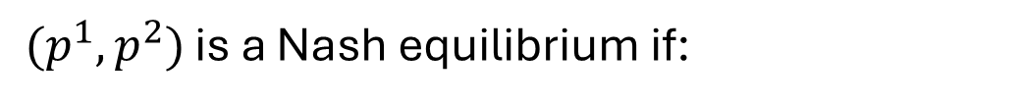
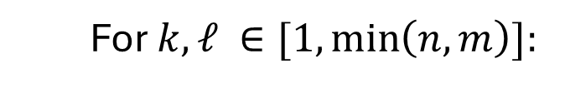
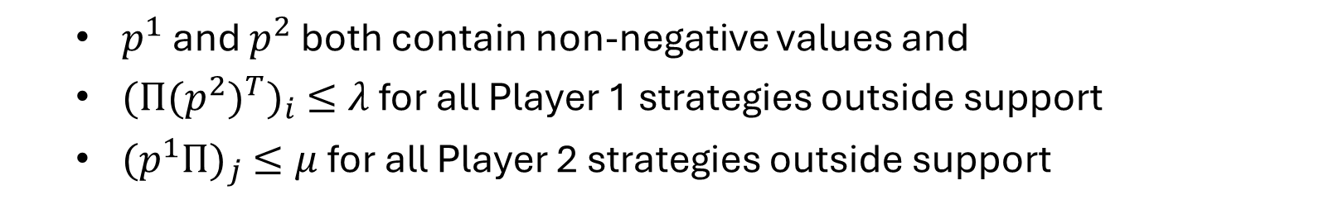
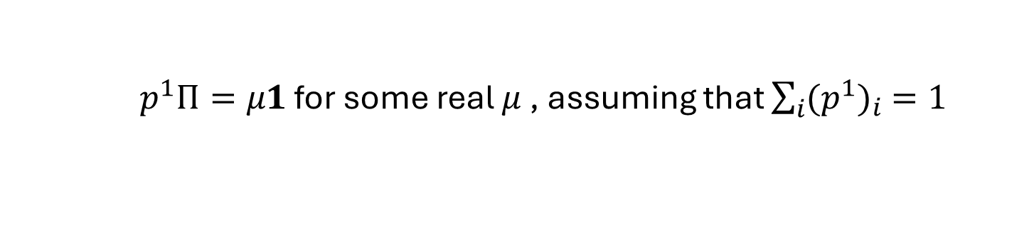
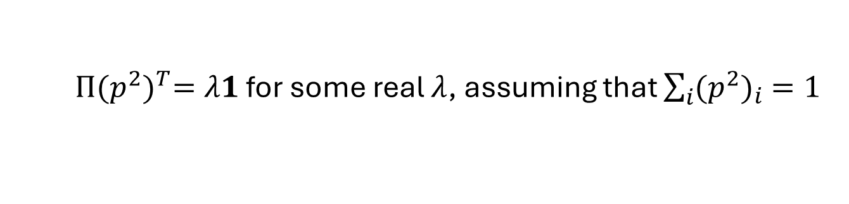
Finding Nash Equilibria in General
  The Python library nashpy has three methods of finding equilibria:
  Support Enumeration
  For $k,ℓ ∈[1, \min\left(n,m\right)]:$
  For all possible ways to select $k$ strategies for Player 1 and $ℓ$ strategies for Player 2:
  Solve the indifference equations:
  $Π{(p^{2})}^{T}=λ1$ for some real $λ$, assuming that $\sum_{i}{{(p^{2})}_{i} =1}$
  $p^{1}Π=μ1$ for some real $μ$ , assuming that $\sum_{i}{{(p^{1})}_{i} =1}$
$(p^{1},p^{2})$ is a Nash equilibrium if:
  $p^{1}$ and $p^{2}$ both contain non-negative values and
  ${(Π{(p^{2})}^{T})}_{i} ≤λ$ for all Player 1 strategies outside support
  ${(p^{1}Π)}_{j} ≤μ$ for all Player 2 strategies outside support

Slide 14


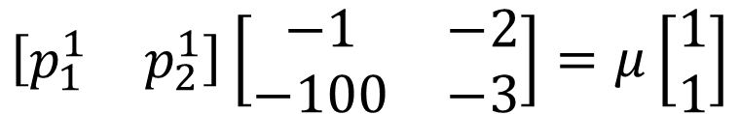
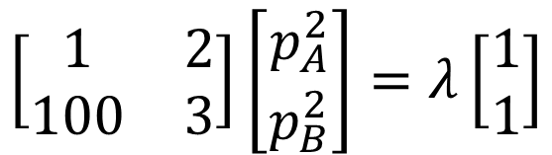
Finding Nash Equilibria in General
  Support Enumeration Example:
  Suppose we choose a support of $\{1,2\}$ for Player 1 and $\{A,C\}$ for Player 2
  The indifference equations:
$$\left[\begin{matrix}1 & 2 \\ 100 & 3\end{matrix}\right]\left[\begin{matrix}p_{A}^{2} \\ p_{B}^{2}\end{matrix}\right]=λ\left[\begin{matrix}1 \\ 1\end{matrix}\right]$$
20
30
2
1
-10
100
$$p_{A}^{2}+p_{B}^{2}=1$$
-10
-20
100
20
1
3
$$\left[\begin{matrix}p_{1}^{1} & p_{2}^{1}\end{matrix}\right]\left[\begin{matrix}−1 & −2 \\ −100 & −3\end{matrix}\right]=μ\left[\begin{matrix}1 \\ 1\end{matrix}\right]$$
$$p_{1}^{1}+p_{2}^{1}=1$$

Slide 15






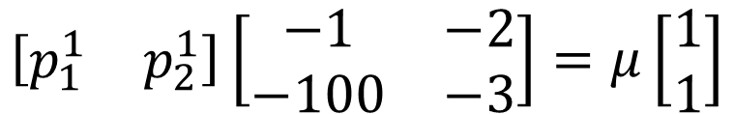

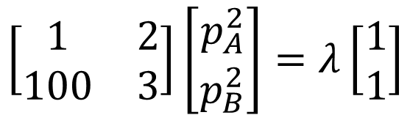

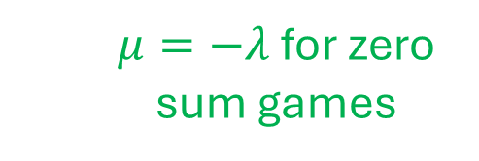
Finding Nash Equilibria in General
  Support Enumeration Example:
  Suppose we choose a support of $\{1,2\}$ for Player 1 and $\{A,C\}$ for Player 2
  Solving the indifference equations, we get:
  Invalid Solution
$$\left[\begin{matrix}1 & 2 \\ 100 & 3\end{matrix}\right]\left[\begin{matrix}p_{A}^{2} \\ p_{B}^{2}\end{matrix}\right]=λ\left[\begin{matrix}1 \\ 1\end{matrix}\right]$$
$$p_{A}^{2}=−1/98$$
$$p_{B}^{2}=99/98$$
$$p_{A}^{2}+p_{B}^{2}=1$$
$$λ=197/98$$
$$\left[\begin{matrix}p_{1}^{1} & p_{2}^{1}\end{matrix}\right]\left[\begin{matrix}−1 & −2 \\ −100 & −3\end{matrix}\right]=μ\left[\begin{matrix}1 \\ 1\end{matrix}\right]$$
$$p_{1}^{1}=97/98$$
$$p_{2}^{1}=1/98$$
$$p_{1}^{1}+p_{2}^{1}=1$$
  $μ=−λ$ for zero sum games
$$μ=−197/98$$

Slide 16
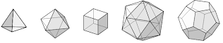

Zero Sum Game with $m$ x $n$ Payoff Matrix
  2. Vertex Enumeration
  We represent the possible payoffs for Player 1 and Player 2 through polytopes
  Since the Nash equilibrium must be on a vertex, we iterate through all possible pairs of fully labeled vertices (one from each polytope)
  A pair of vertices is fully labeled if they satisfy the Strong Minimax Theorem:
  Either $\sum_{i=1}^{m}{p_{i}^{1∗}Π_{ij}=V}$ or $p_{j}^{2∗}=0$ for all $j$
  Either $\sum_{j=1}^{n}{Π_{ij}{(p_{j}^{2∗})}^{T}=V}$ or $p_{i}^{1∗}=0$ for all $i$

Slide 17
Zero Sum Game with $m$ x $n$ Payoff Matrix
  How do we solve zero sum games in general?
  The Python library nashpy has three methods of finding equilibria:
  3. Lemke Howson Algorithm
  Very efficient but not guaranteed to find all of the Nash equilibria

Slide 18
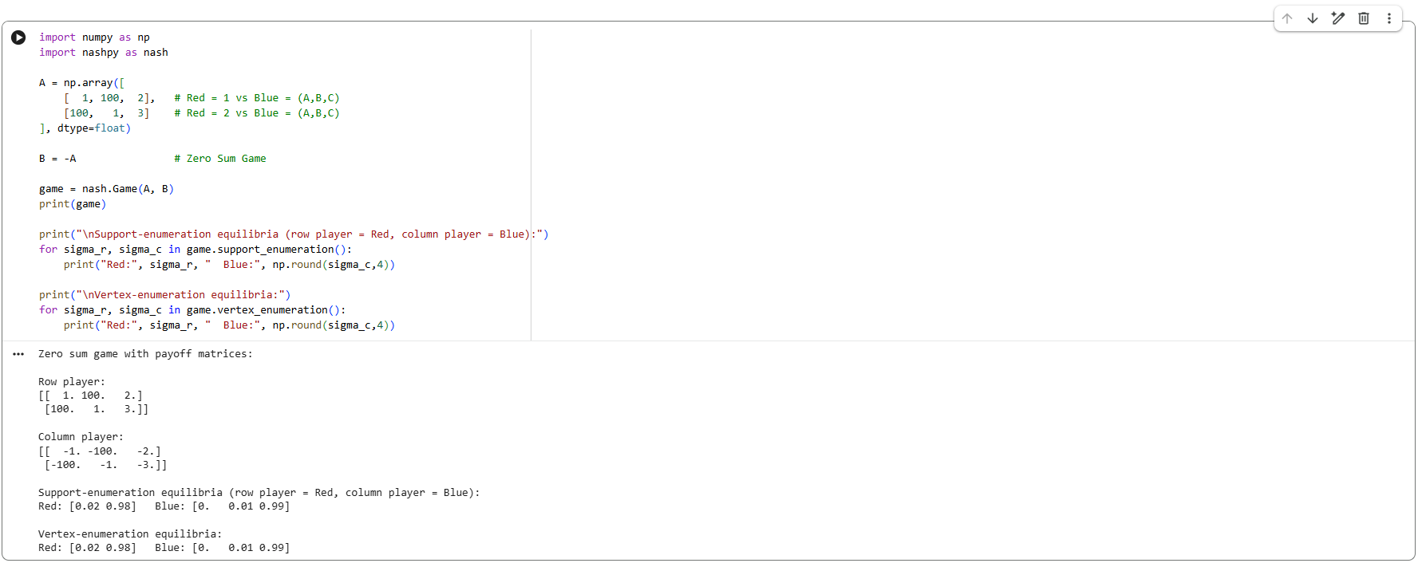
Sample NashPy Code

Slide 19
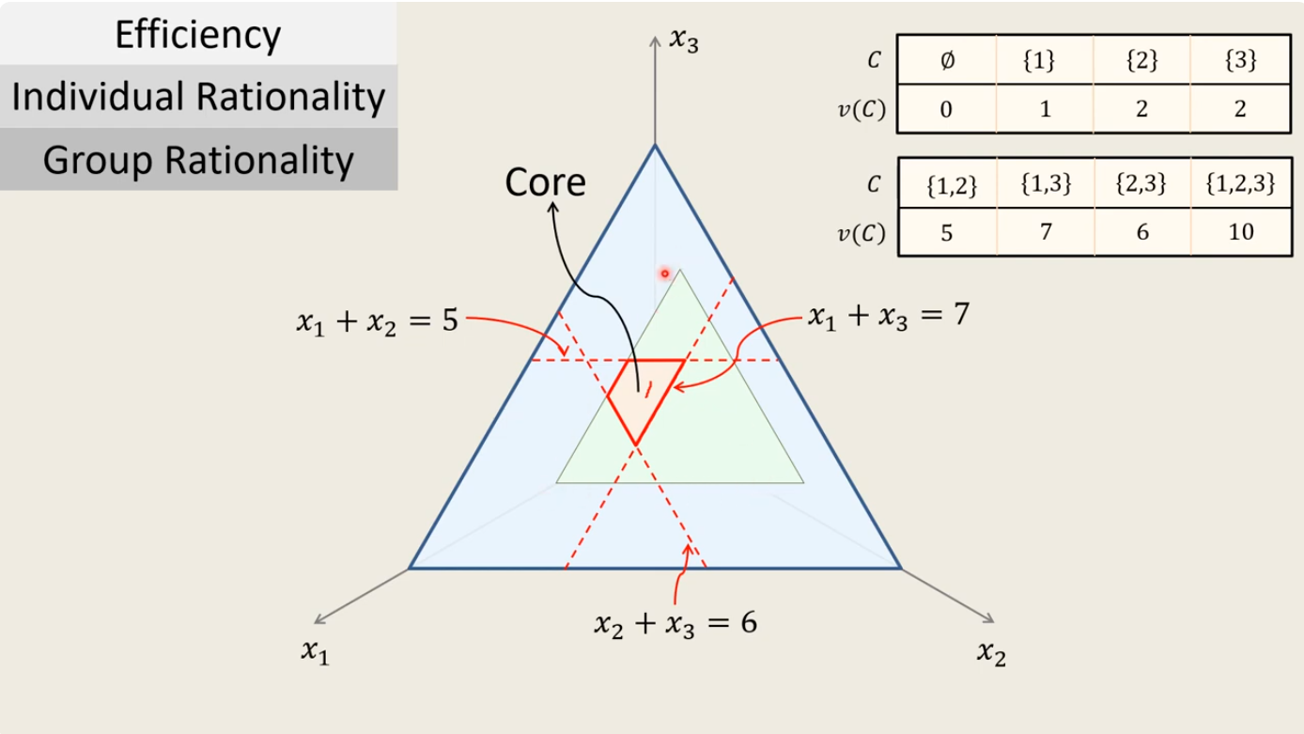
Imputations and
von Neumann-Morgenstern solutions

Slide 20
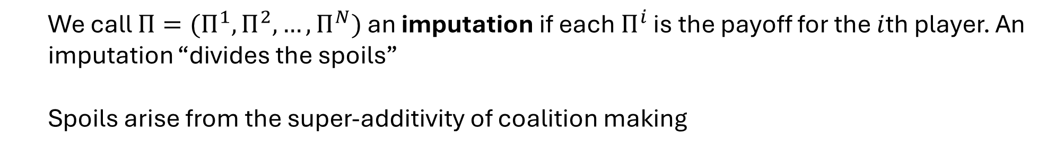
Imputations
  We call $Π=(Π^{1},Π^{2},…,Π^{N})$ an imputation if each $Π^{i}$ is the payoff for the $i$th player. An imputation “divides the spoils”
  Spoils arise from the super-additivity of coalition making

Slide 21
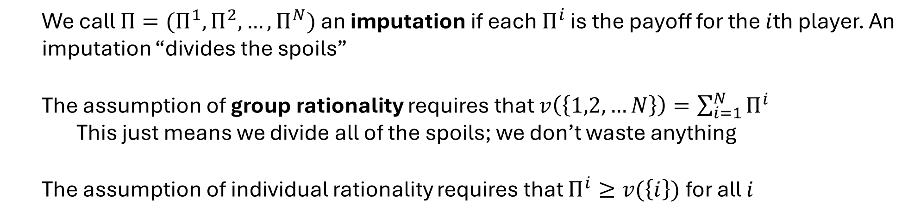
Imputations and Rationality
  We call $Π=(Π^{1},Π^{2},…,Π^{N})$ an imputation if each $Π^{i}$ is the payoff for the $i$th player. An imputation “divides the spoils”
  The assumption of group rationality requires that $v\left(\left\{1,2,…N\right\}\right)=\sum_{i=1}^{N}{Π^{i}}$
  This just means we divide all of the spoils; we don’t waste anything
  The assumption of individual rationality requires that $Π^{i}≥v(\left\{i\right\})$ for all $i$

Slide 22
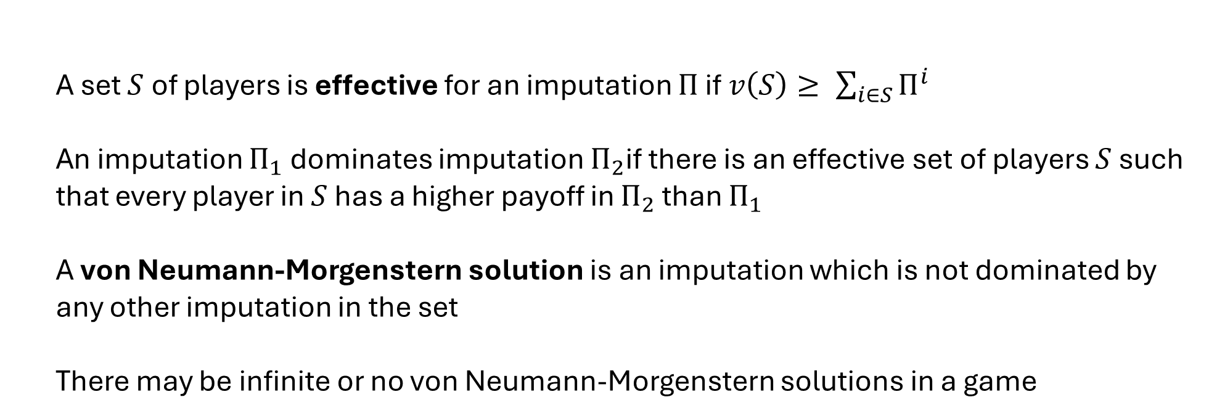
Effective Coalitions
  A set $S$ of players is effective for an imputation $Π$ if $v\left(S\right)≥ \sum_{i∈S}{Π^{i}}$
  An imputation $Π_{1}$ dominates imputation $Π_{2}$if there is an effective set of players $S$ such that every player in $S$ has a higher payoff in $Π_{2}$ than $Π_{1}$
  A von Neumann-Morgenstern solution is an imputation which is not dominated by any other imputation in the set
  There may be infinite or no von Neumann-Morgenstern solutions in a game

Slide 23
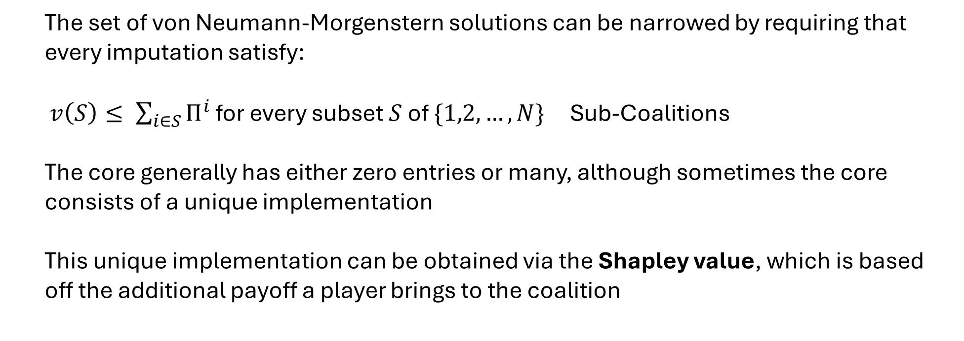
The Core
  The set of von Neumann-Morgenstern solutions can be narrowed by requiring that every imputation satisfy:
  $v\left(S\right)≤ \sum_{i∈S}{Π^{i}}$ for every subset $S$ of $\{1,2,…,N\}$ Sub-Coalitions
  The core generally has either zero entries or many, although sometimes the core consists of a unique implementation
  This unique implementation can be obtained via the Shapley value, which is based off the additional payoff a player brings to the coalition

Slide 24
Control Theory
From
Mathematical Optimization and Economic Theory
Jacob Wyngaard

